Slide 1
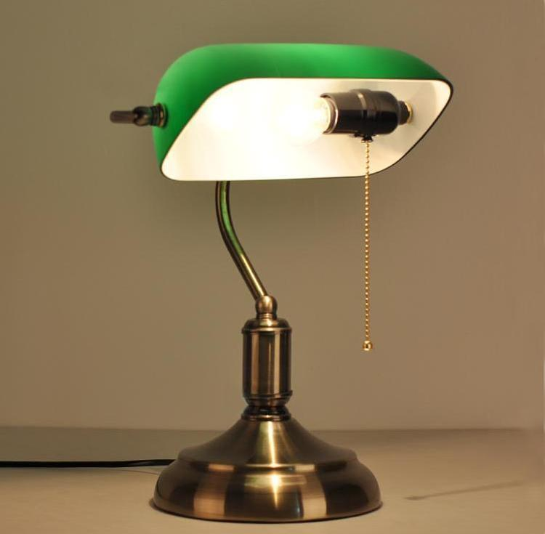
Daily Review
Describing Light Related Properties of Objects
Does the object produce light? yes = luminous no = non-luminous If no, how much light can pass through the object? none, it is reflected = opaque some, blurry image = translucent all, clear image = transparent
Describe the light related properties of each part of the lamp.
Lamp shade
Metal base
Light bulb

Slide 2
Daily Review
Using the Law of Reflection
Label the incident ray (i) and reflected ray (r). Locate or draw the normal and label it (N). Label the angle of incidence (ϴ_{i}) and/or the angle of reflection (ϴ_{r}) Remember the angle of reflection is always equal the angle of incidence.
Draw and complete the diagram on your whiteboard.
ϴ_{i} = 70°

Slide 3
Daily Review
Using the Law of Reflection
Label the incident ray (i) and reflected ray (r). Locate or draw the normal and label it (N). Label the angle of incidence (ϴ_{i}) and/or the angle of reflection (ϴ_{r}) Remember the angle of reflection is always equal the angle of incidence.
Draw and complete the diagram on your whiteboard.
80°

Slide 4
Types of Curved Mirrors Year 9 Physics

Slide 5
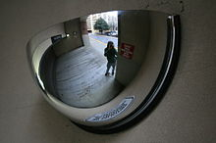
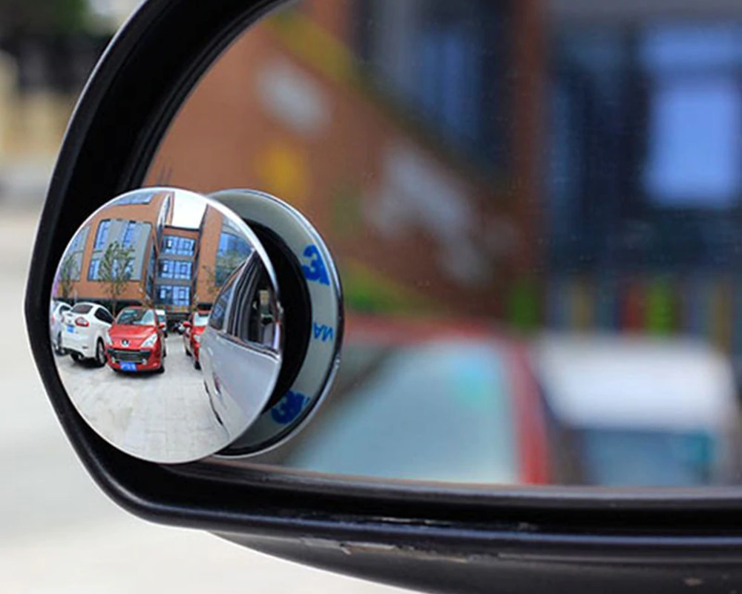
Learning Objectives
CFU
What are we going to learn?
Identify the different types of curved mirrors.
Describe the types of images formed in curved mirrors.
Activate Prior Knowledge
People often use outwardly curving mirrors on the corners of buildings or on the side mirrors of their cars.
What advantage do these type of mirrors give people?

Slide 6
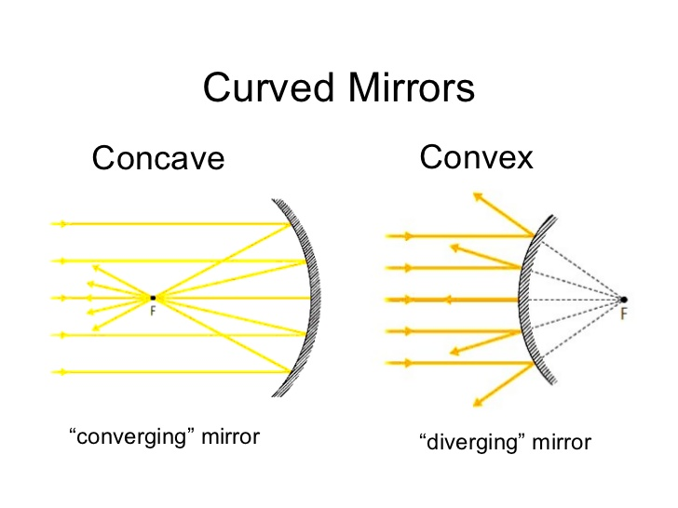
Concept Development
Handy Hint:
Concave mirrors curve inwards like a cave.
CFU 1
How is the shape of a concave mirror different to a convex mirror?
Curved Mirrors
There are two types of curved mirrors:
Concave mirrors – mirrors that curve inwards
Concave mirrors focus light to a point.
Convex mirrors – mirrors that curve outwards
Convex mirrors spread light outwards
CFU 2
What does a concave mirror do to light?
CFU 3
What does a convex mirror do to light?

Slide 7
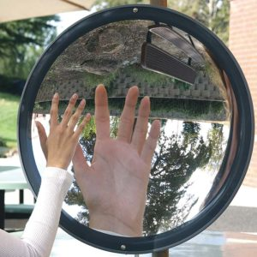
Concept Development
CFU 1
Which two words are used to describe the size of the image?
Language of Light
There are certain words used to describe the images produced by mirrors.
Images that appear bigger than the object are magnified.
Images that appear smaller than the object are diminished.
Images that appear the right way up are upright.
Images that appear upside down are inverted.
CFU 2
How is an upright image different to an inverted image?
CFU 3
How would you describe an image that was upside down and smaller than the object?
CFU 4
How would you describe the image of the hand in the mirror?

Slide 8
Concept Development
CFU 1
True or false: in a convex mirror, the surface curves outwards
Convex Mirrors
Convex mirrors gather light from large area.
They produce a diminished and upright image.
Convex mirrors are used when a wide view is needed.
Car side mirrors and security mirrors at shops and dangerous intersections are convex mirrors.
CFU 2
What sort of image do convex mirrors produce?
CFU 3
When are convex mirrors useful?

Slide 9
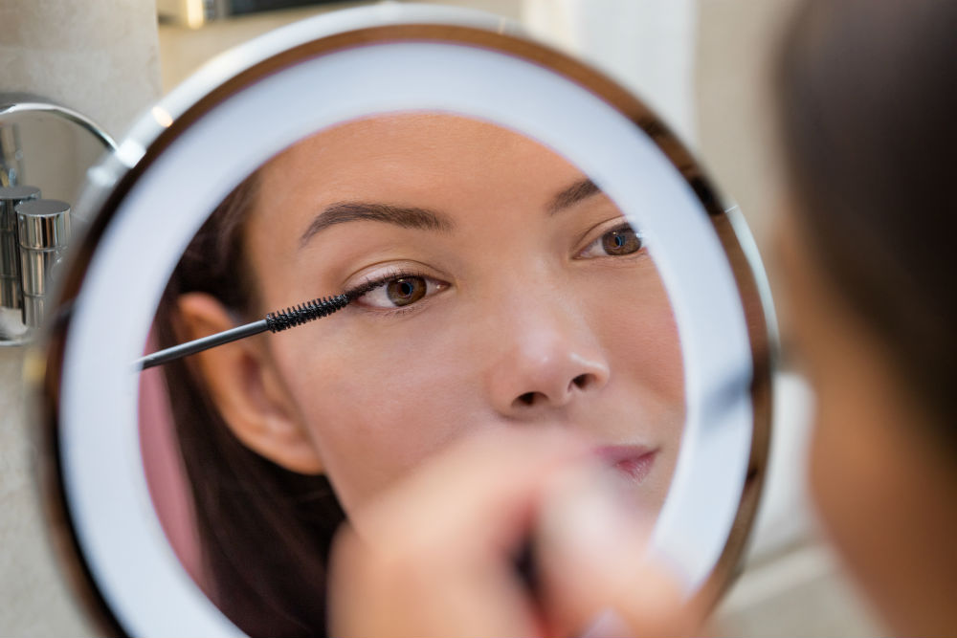
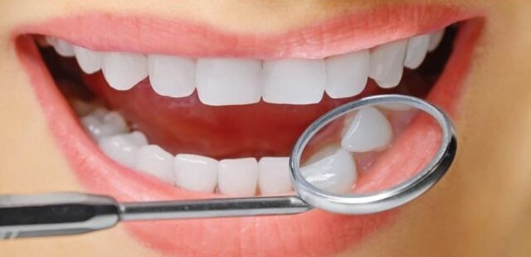
Concept Development
CFU 1
True or false: in a concave mirror, the surface curves outwards
Concave Mirrors
Two types of image are produced by concave mirrors, depending on the distance between the object and mirror.
An object very close to a concave mirror, produces a magnified and upright image.
They are useful for shaving or applying makeup, and when a dentist needs to look at teeth.
CFU 2
When sort of image do concave mirrors produce when the object is very close?
CFU 3
When are concave mirrors useful close up?

Slide 10
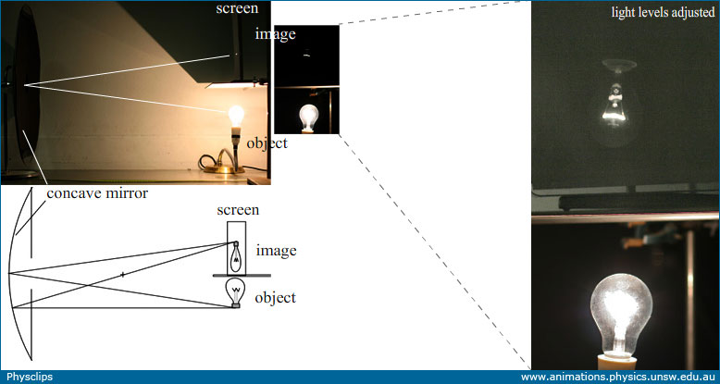
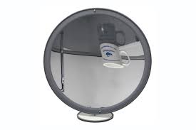
Concept Development
CFU 1
When sort of image do concave mirrors produce when the object is far away?
Concave Mirrors
Two types of image are produced by concave mirrors, depending on the distance between the object and the mirror
An object far from a concave mirror, produces a diminished and inverted image.
They are useful for projecting images onto a screen.
CFU 2
When are concave mirrors useful at a distance?

Slide 11
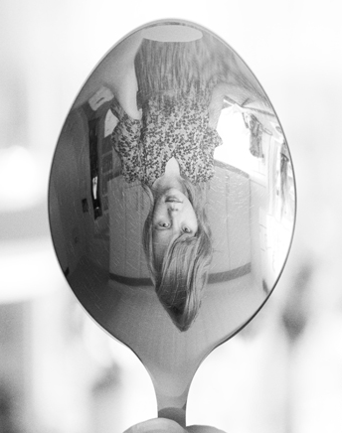
Skill Development/Guided Practice
Reminder:
Bigger = magnified Smaller = diminished Right way up = upright Upside down = inverted
CFU 1
What words can be used to describe the image?
Images in Curved Mirrors
Describe the image formed using the terms below. Use the image type to identify type of mirror: Convex = diminished and upright Concave (close) = magnified and upright Concave (far away) = diminished and inverted
CFU 2
What type of mirror has been used?
The image is diminished and inverted.
This mirror is a concave mirror with the object far away.

Slide 12
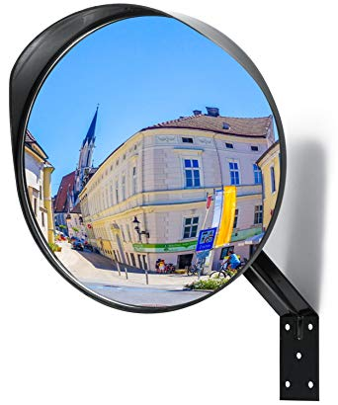
Skill Development/Guided Practice
Reminder:
Bigger = magnified Smaller = diminished Right way up = upright Upside down = inverted
CFU 1
What words can be used to describe the image?
Images in Curved Mirrors
Describe the image formed using the terms below. Use the image type to identify type of mirror: Convex = diminished and upright Concave (close) = magnified and upright Concave (far away) = diminished and inverted
CFU 2
What type of mirror has been used?
The image is diminished and upright.
This mirror is a convex mirror.

Slide 13
Skill Development/Guided Practice
Reminder:
Bigger = magnified Smaller = diminished Right way up = upright Upside down = inverted
CFU 1
What words can be used to describe the image?
Images in Curved Mirrors
Describe the image formed using the terms below. Use the image type to identify type of mirror: Convex = diminished and upright Concave (close) = magnified and upright Concave (far away) = diminished and inverted
CFU 2
What type of mirror has been used?
The image is ______ and ______. This mirror is a _______mirror with the object ________.

Slide 14
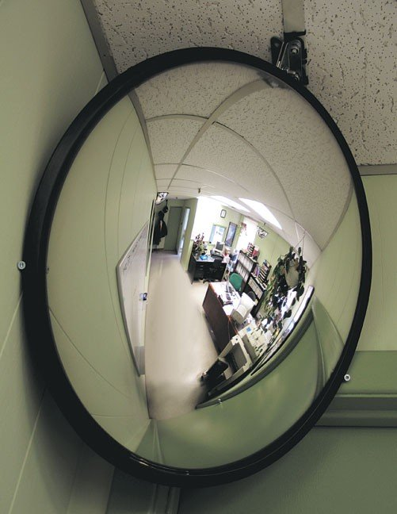
Skill Development/Guided Practice
Reminder:
Bigger = magnified Smaller = diminished Right way up = upright Upside down = inverted
CFU 1
What words can be used to describe the image?
Images in Curved Mirrors
Describe the image formed using the terms below. Use the image type to identify type of mirror: Convex = diminished and upright Concave (close) = magnified and upright Concave (far away) = diminished and inverted
CFU 2
What type of mirror has been used?
The image is ______ and ______. This mirror is a _______mirror with the object ________.

Slide 15
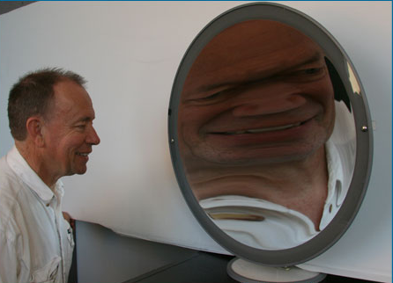
Skill Development/Guided Practice
Reminder:
Bigger = magnified Smaller = diminished Right way up = upright Upside down = inverted
CFU 1
What words can be used to describe the image?
Images in Curved Mirrors
Describe the image formed using the terms below. Use the image type to identify type of mirror: Convex = diminished and upright Concave (close) = magnified and upright Concave (far away) = diminished and inverted
CFU 2
What type of mirror has been used?
The image is ______ and ______. This mirror is a _______mirror with the object ________.

Slide 16
Relevance
Light reflects off curved mirrors in predictable ways, producing different types of images.
Curved mirrors have many applications:
They can be used to magnify an image so you can see detail more clearly.
They can be used to project images onto a screen.
They can be used to see a wider area in shopping centres or around corners in dangerous places.

Slide 17
Skill Closure
Images in Curved Mirrors
Describe the image formed using the terms below. Use the image type to identify type of mirror: Convex = diminished and upright Concave (close) = magnified and upright Concave (far away) = diminished and inverted
Explain the difference between concave and convex mirrors.
Skill Closure
What are the terms used for an image that is:
Upside down? Smaller? Right way up? Bigger?
Skill Closure
Describe the image in the mirror in the picture. What type of mirror is shown?
Reminder:
Bigger = magnified Smaller = diminished Right way up = upright Upside down = inverted

Slide 18
Independent Practice
Complete the questions below on your device or in your book.
Explain the difference between a concave and a convex mirror. Draw a diagram of each type of mirror.
What type of image is formed in a convex mirror? Describe when convex mirrors are useful in everyday life.
What type of image is formed in a concave mirror when the object is far away? Describe what concave mirrors can be used to do when the object or light is far away.
What type of image is formed in a concave mirror when the object is close to the mirror? Describe when concave mirrors are useful in everyday life and the object is close to the mirror.
Complete the worksheet “Reflection of Light” on your device or a paper copy.

